Slide 1
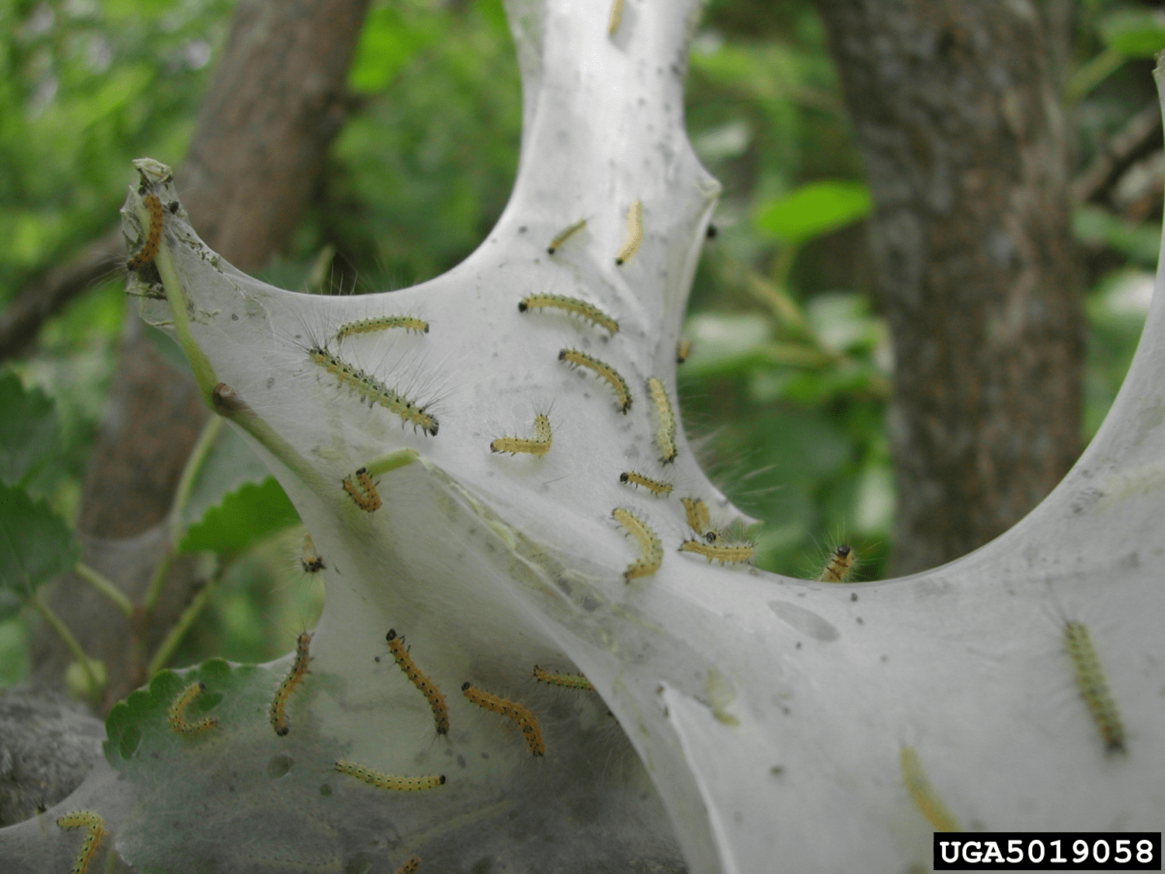
Bio AI
Team 1
Szabi
Robin
Corné
Luka
Laura

Slide 2
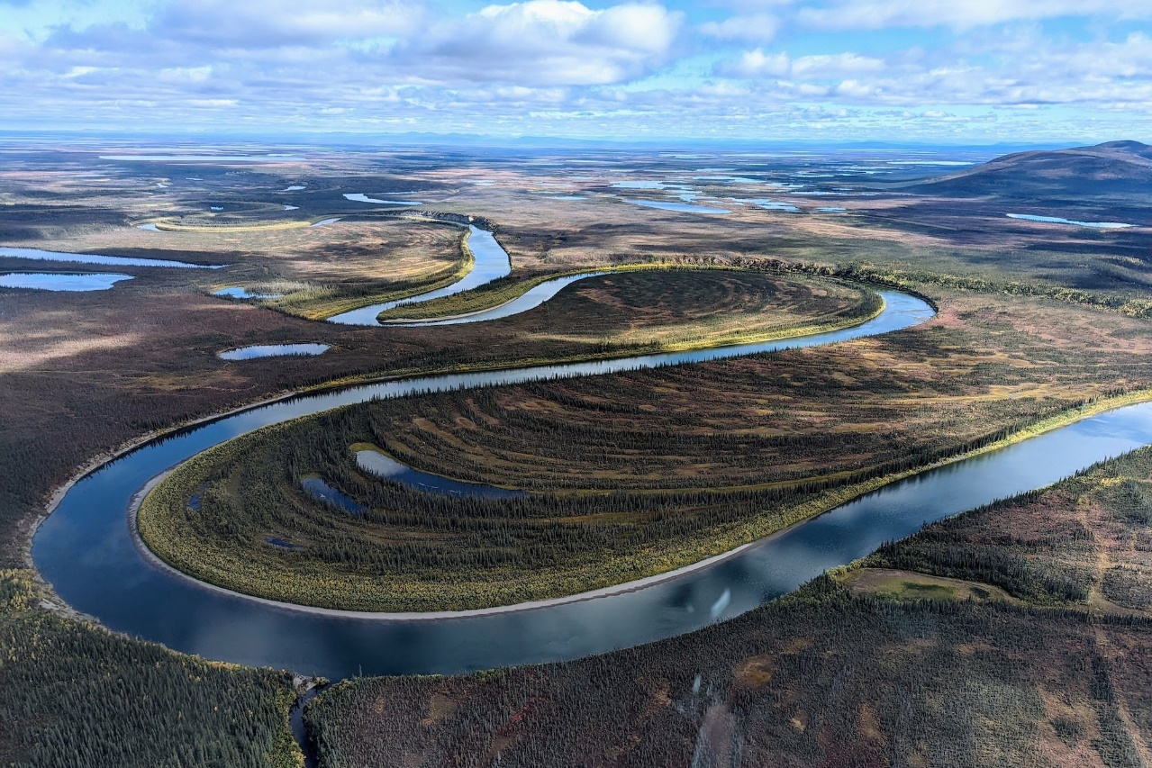
Inspiration

Slide 3
Concept

Slide 9
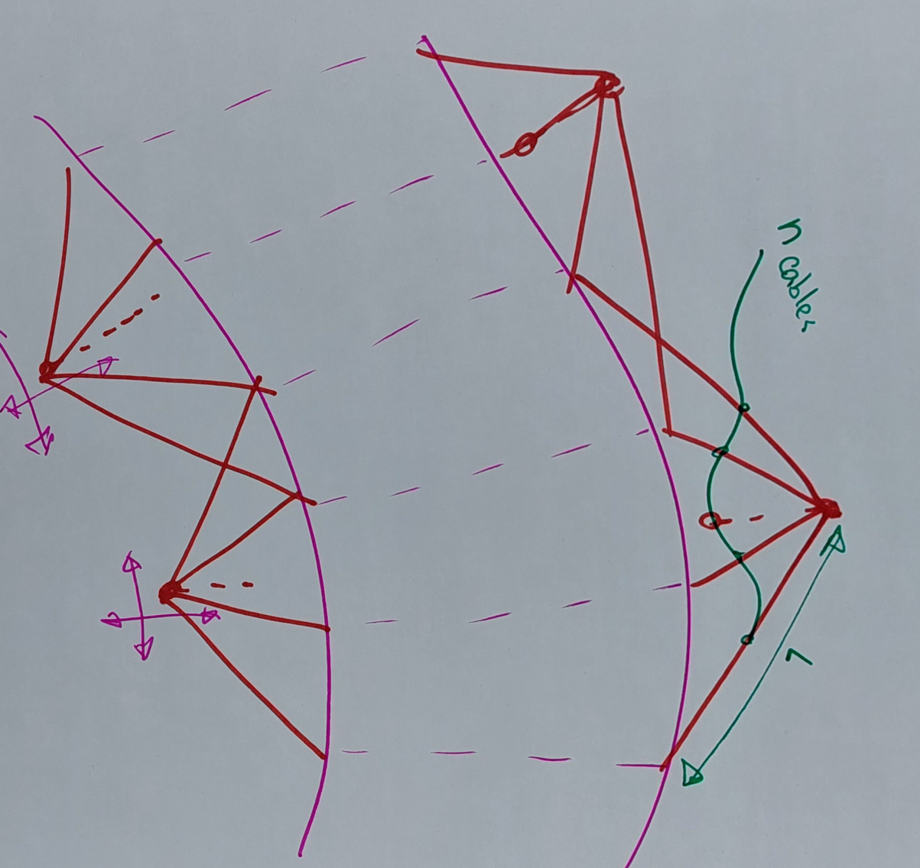

Slide 10
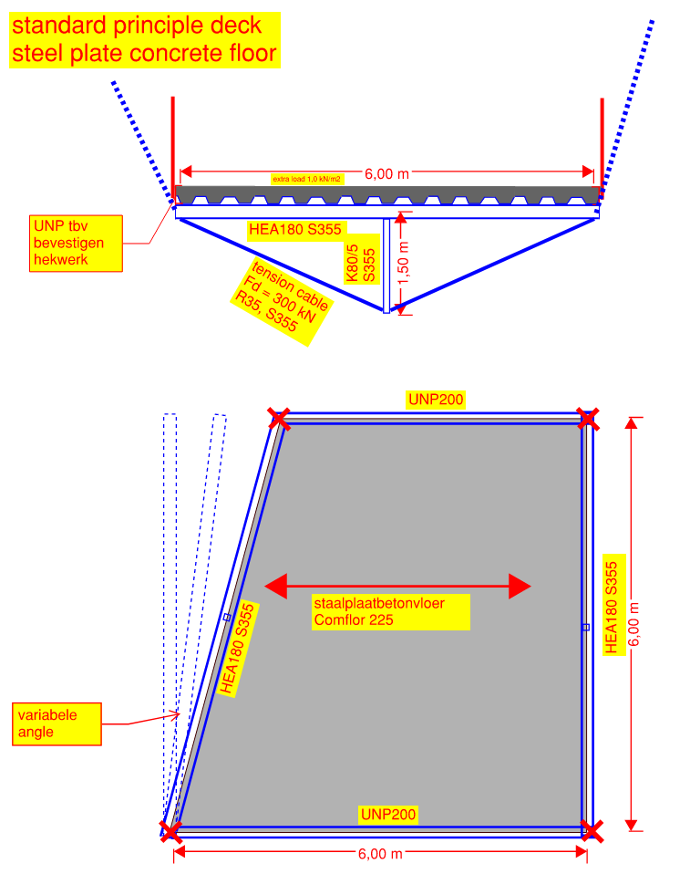
Cross sections deck

Slide 11
Sustainability
MKI
Main load bearing structure E12.500
Deck E18.000
Total exp foundation: E20.500

