Slide 1
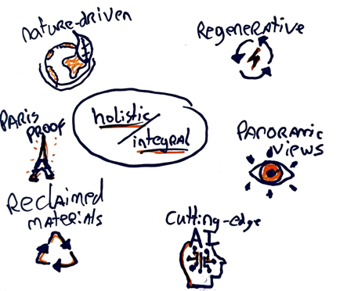
Paragraph Pioneers A new paragraph in sustainable design
Miel Beekman
Katinka Verleg
Erron Estrado
Rick Titulaer

Slide 2
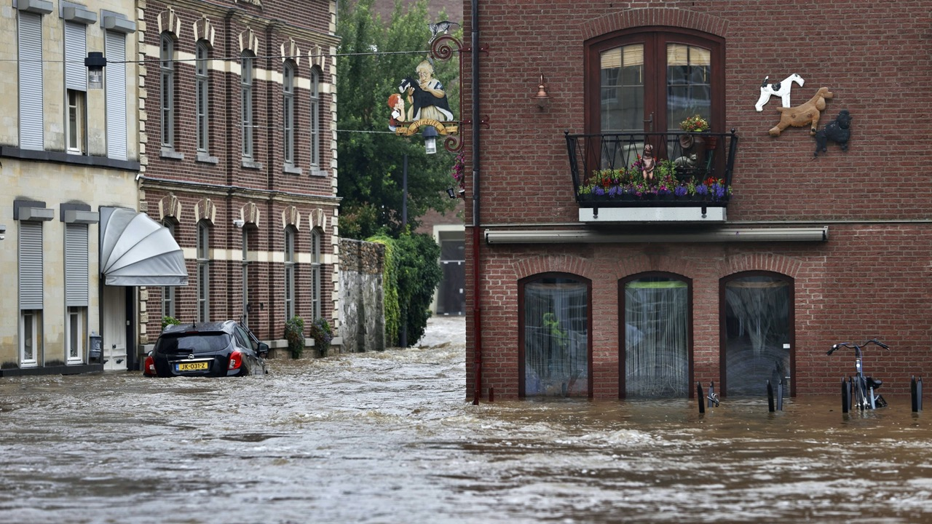
Urgence
Notes:
We all know the urgence to start designing paris proof to stay within the 1,5 degree limit.

Slide 3
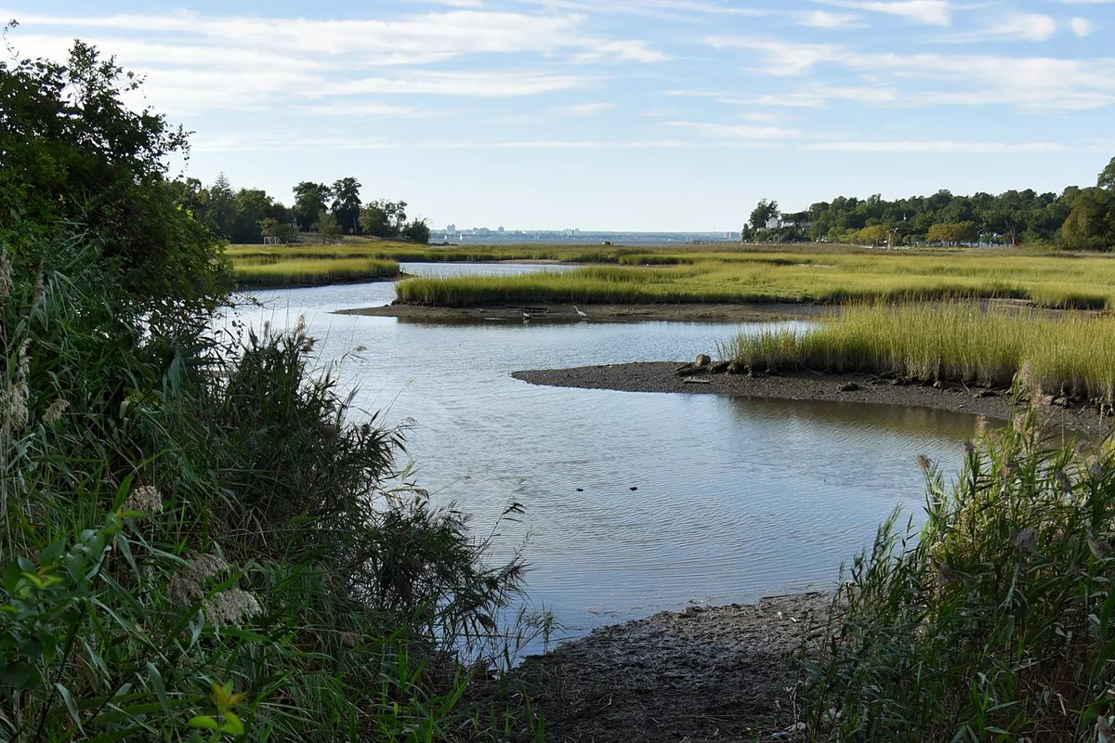
Biodiversity loss
Notes:
We all know the urgence to start designing paris proof to stay within the 1,5 degree limit.

Slide 4
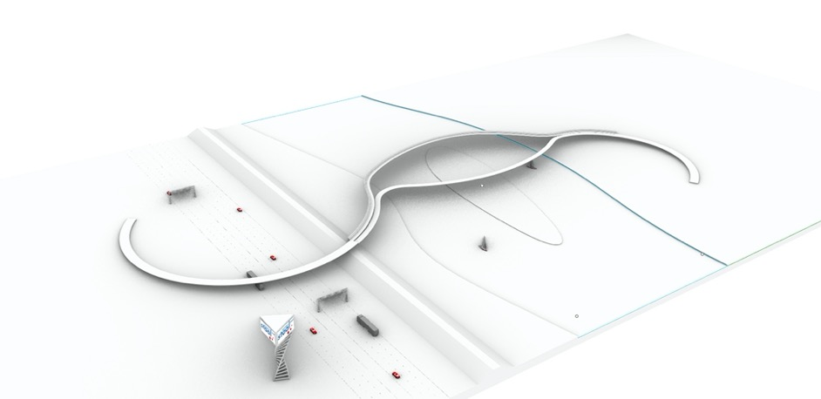
Design Concept
Notes:
We all know the urgence to start designing paris proof to stay within the 1,5 degree limit.

Slide 5
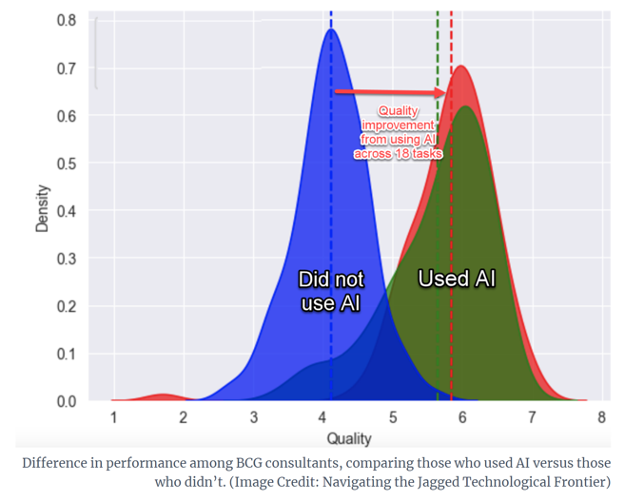
Harvard Business School, September 2023
How? AI Driven

Slide 6
Ideation
AI Driven
Optimisation
Presentation
Notes:
We all know the urgence to start designing paris proof to stay within the 1,5 degree limit.

Slide 7
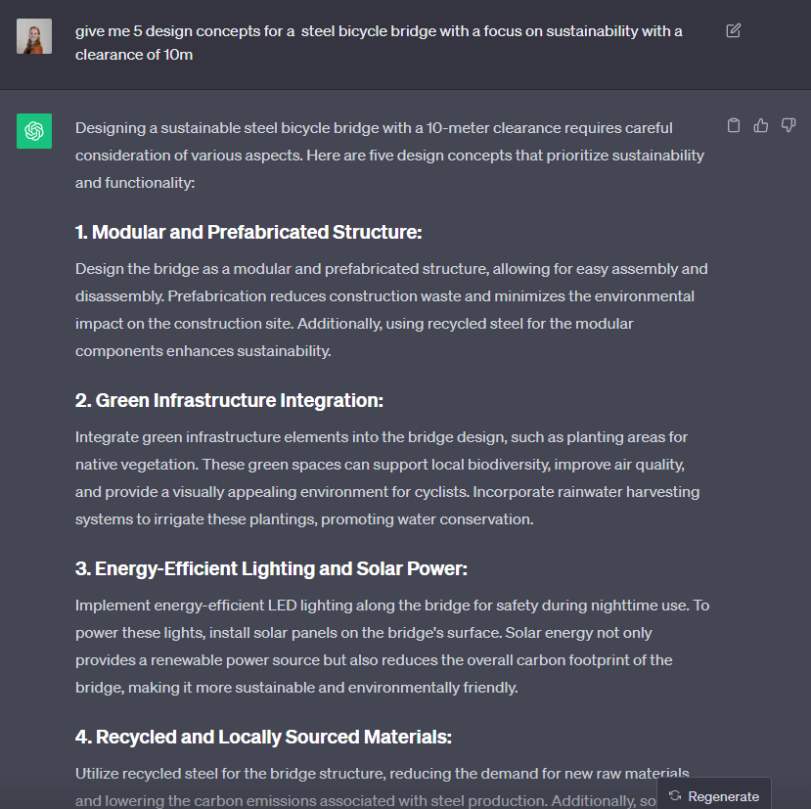
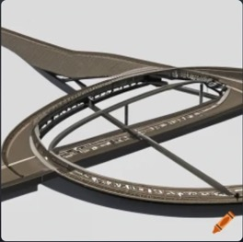
Ideation
ChatGPT – Bridge sustainability

Slide 8
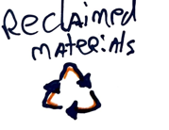
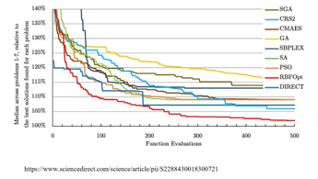
Optimisation I
Bridge parameters
SPEA-2
Maximise
GA
SA
NSGA-2
K-means
Reclaimed steel
RBFOpt
CMA-ES
RBFMOpt
MACO
MOEA
NSGA-2
NSPSO
Minimise
jEDE
NMD
1.110 0.080 0.510 0.000 0.000 0.000 0.000 0.480 0.000 0.030 0.000 -0.040 2.170
1.120 0.020 0.050 0.000 0.000 0.000 0.000 0.050 0.010 0.030 0.000 -0.760 0.520
Virgin Steel
Re-used Steel
In
Process
Out
In
Process
Out

Slide 9
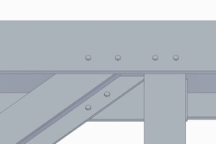
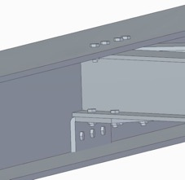
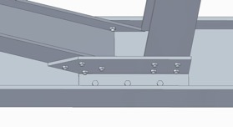
Optimisation I
Demountable, reusable, and transportable

Slide 10
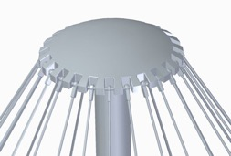
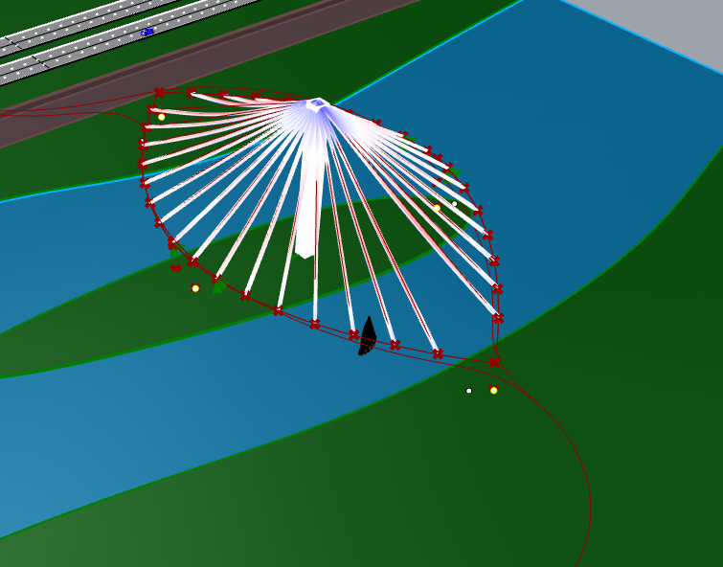
Detailing:
Integral Design
Parameters:
Pylon
section width
Height
Tilt
Position
Cables
Span between
cables
Safety:
Pylon
Pylon bending, shear, normal force, stability
UC = 0.98
Cables
Normal force cables
UC = 0.9
Minimise
In
Process
Out

Slide 11
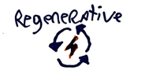
Optimisation II
Maximise
Bridge parameters
SPEA-2
GA
SA
NSGA-2
K-means
Maximise
Bee
RBFOpt
CMA-ES
RBFMOpt
MACO
MOEA
NSGA-2
NSPSO
jEDE
Maximise
Icon
In
Process
Out

Slide 12
Optimisation II

Slide 13
Presentation

Slide 15
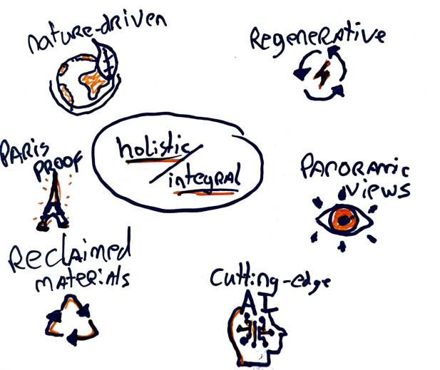
Conclusion

