Slide 1
AI-Powered Bridge
Robin van der Have, Steven Janssens, Nikolai Basalaev & Amy Sterrenberg

Slide 2
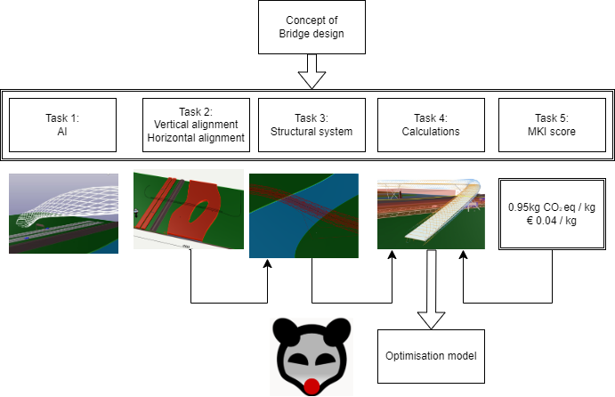
Collaboration

Slide 3
Architectural Vision (by ChatGPT)
"Form Follows AI" defines our Tubular Steel Bridge, where AI-driven design creates a sustainable and captivating landmark, embodying the future of intelligent architecture.

Slide 4
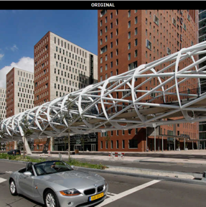
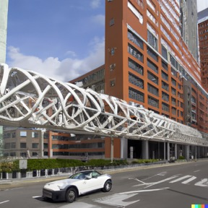
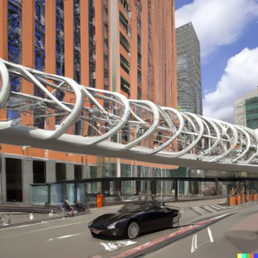
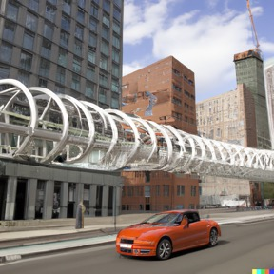
Design Variations by Dall-e 2
Beatrixlaan, Den Haag
(ZJA, 2006)

Slide 5
Chat GPT Code
Can ChatGPT beat architects & engineers?
Initial prompt:
Generate python code to be used in rhino grasshopper that describes elements in a truss bridge. Inputs are the center curve of the bridge.

Slide 6
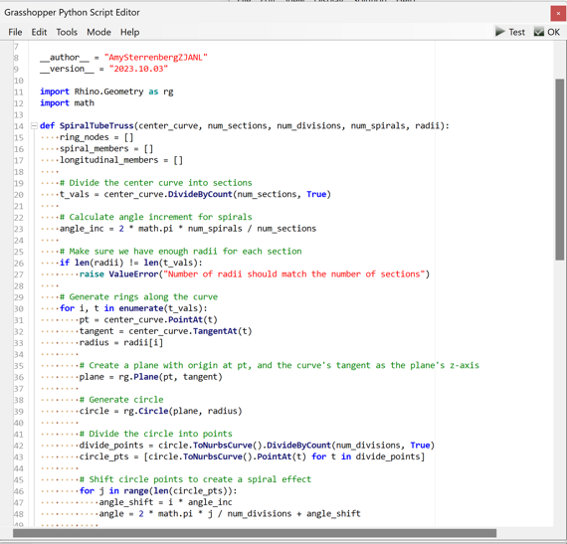
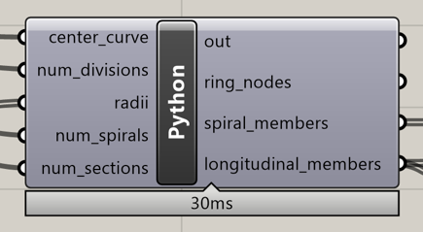
Chat GPT Code

Slide 7
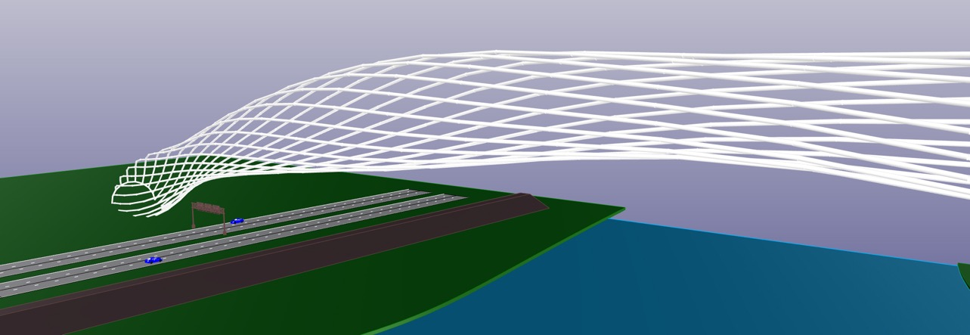
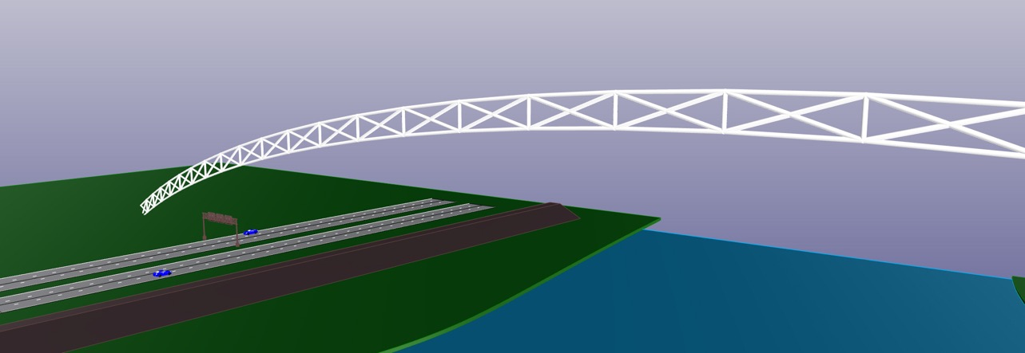
Chat GPT Code

Slide 8
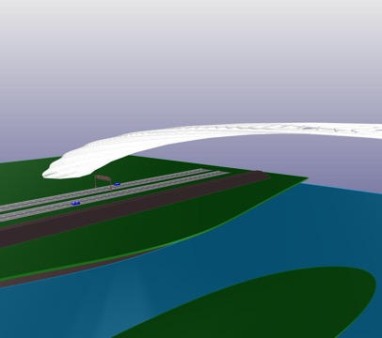
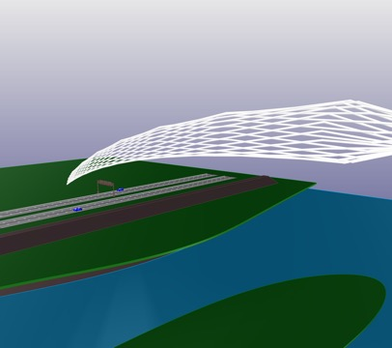
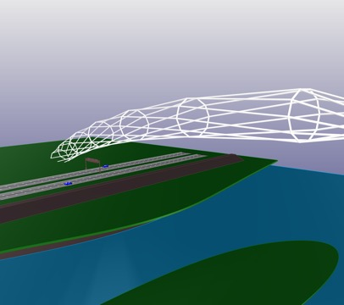
Chat GPT Code

Slide 9
Chat GPT Code- Final product:

Slide 10
General Requirements: Height & Inclination

Slide 11
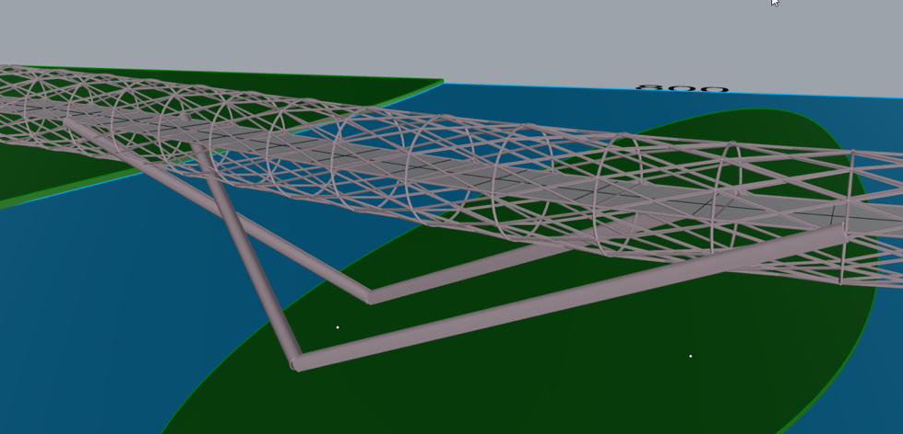
Design

Slide 12
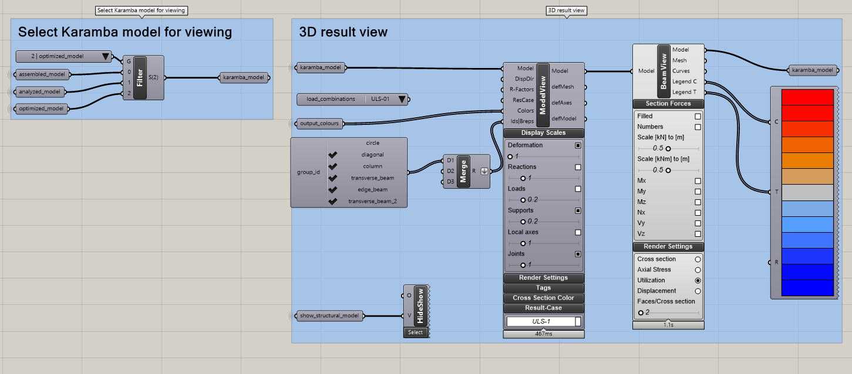
Karamba

Slide 13
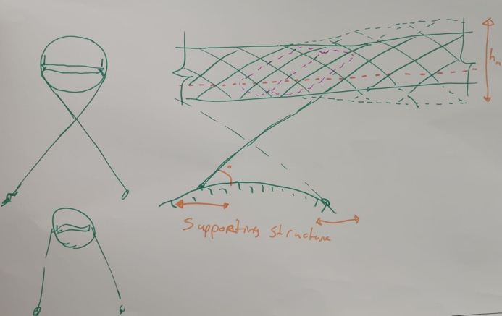
Parameters
Spacing of circles
Circle division
Column angle

Slide 14
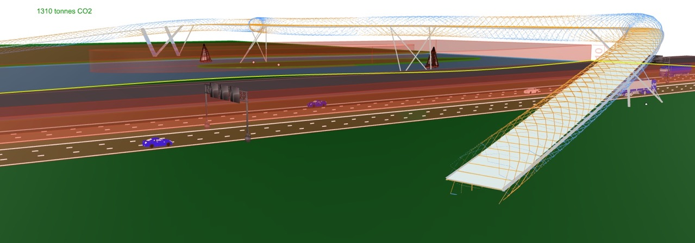
Karamba

Slide 15
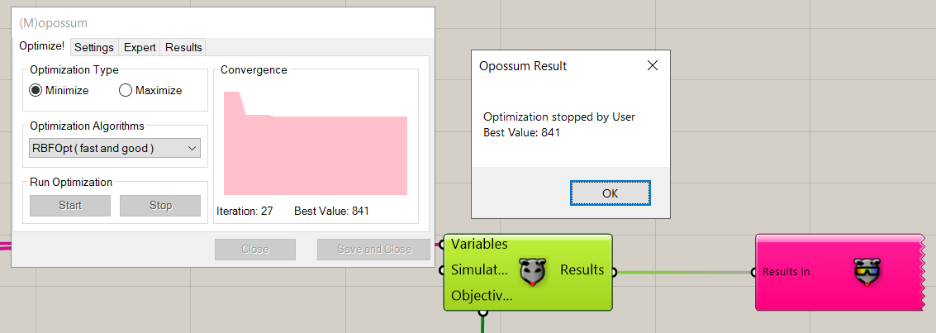
Sustainability (MKI)
1310 tonnes CO2

Slide 16
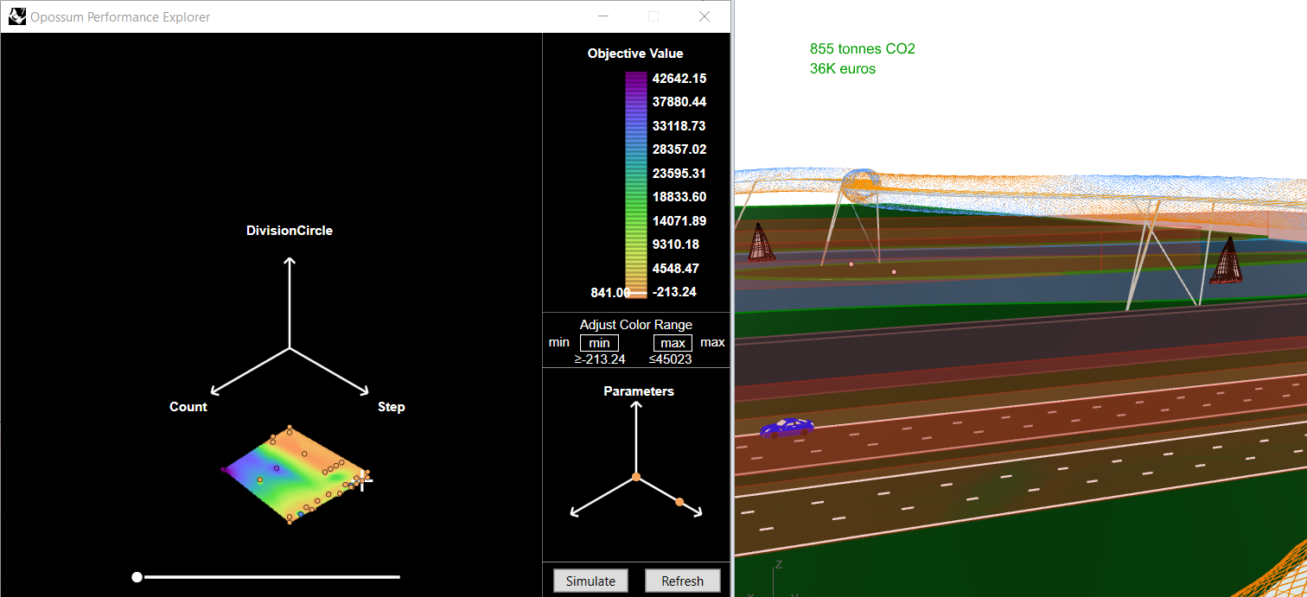
Opossum

Slide 17
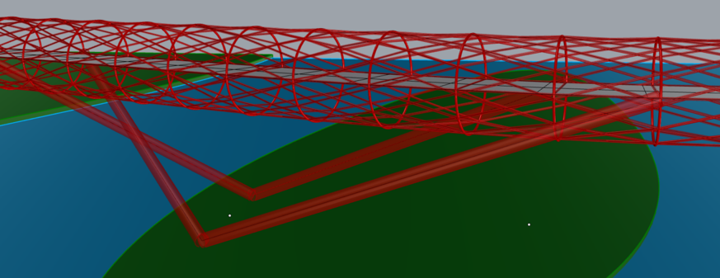
Buildability & Transport
The design consists of many elements, making it easily transportable.

Slide 18
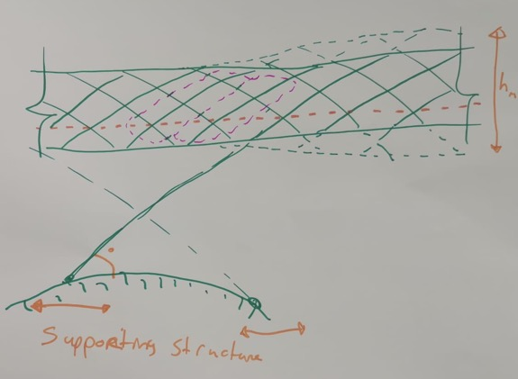
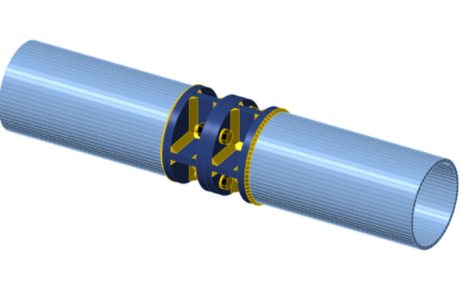
Design details

Slide 19
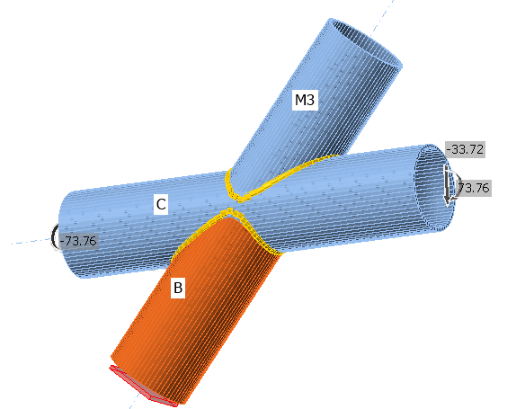
Design details

Slide 20
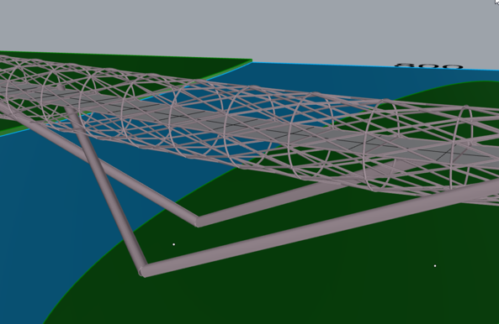
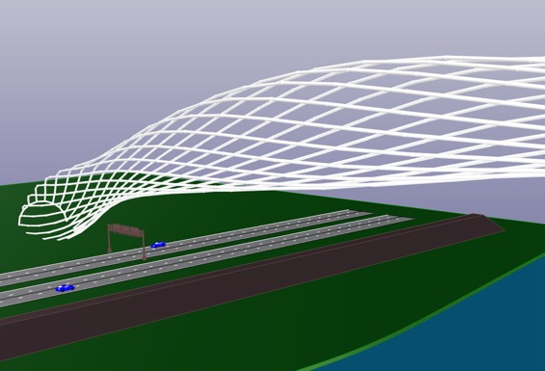
Thank you!
Robin van der Have, Steven Janssens, Nikolai Basalaev & Amy Sterrenberg

