Slide 1
Final4
Joris
Tessa
Yannick
Baqir

Slide 2
Collaboration
Concept all together
Split in 2 groups at design phase
Yannick & Tessa
Joris & Baqir
Joris & Baqir

Slide 3
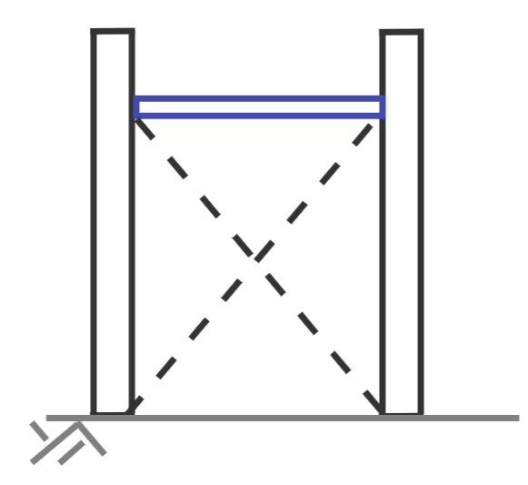
Concept design approach bridges

Slide 4
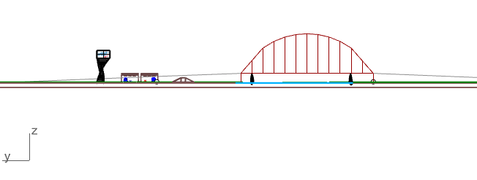
Parametric design arch
Parameters:
Number of hangers (n)
max distance = 25m
Height of arch (h)
W=5.6m
n
h
L=150m

Slide 5
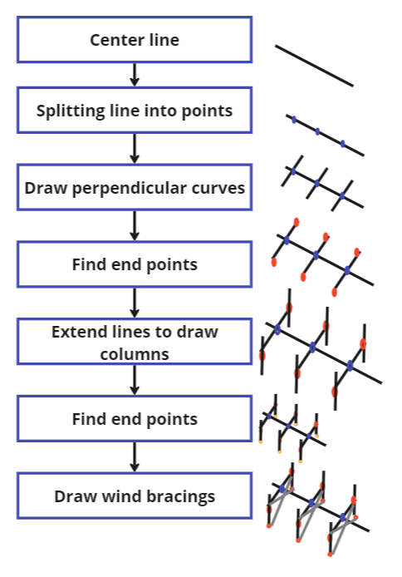
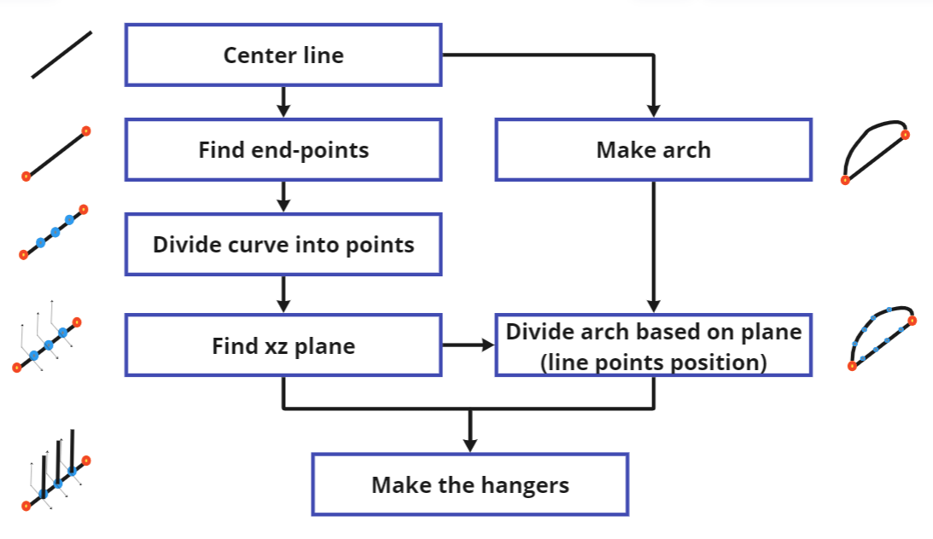
Flowcharts Parametric thinking

Slide 6
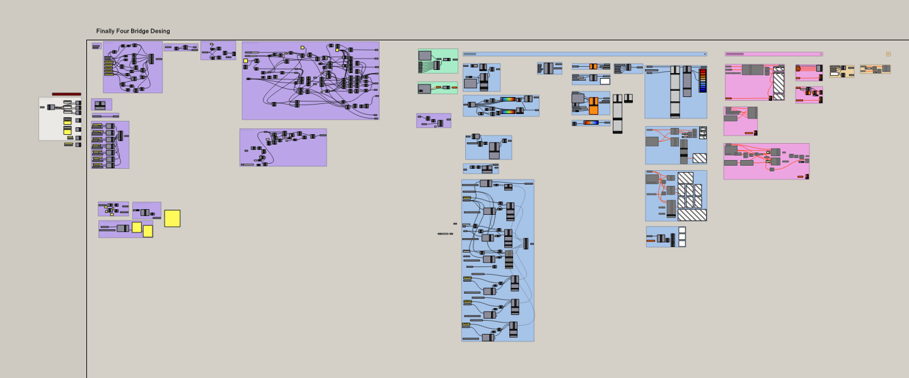
Parametric design

Slide 7
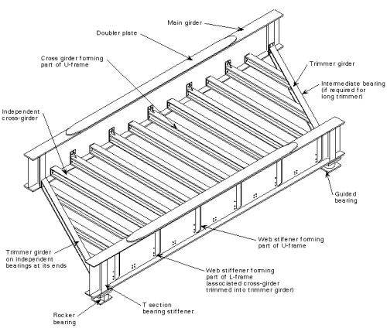
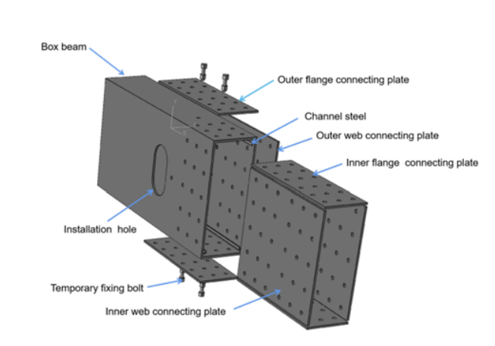
Arch
Demountable
Connection MG-CG is bolted
Arch and MG segments are bolted to eachother

Slide 8
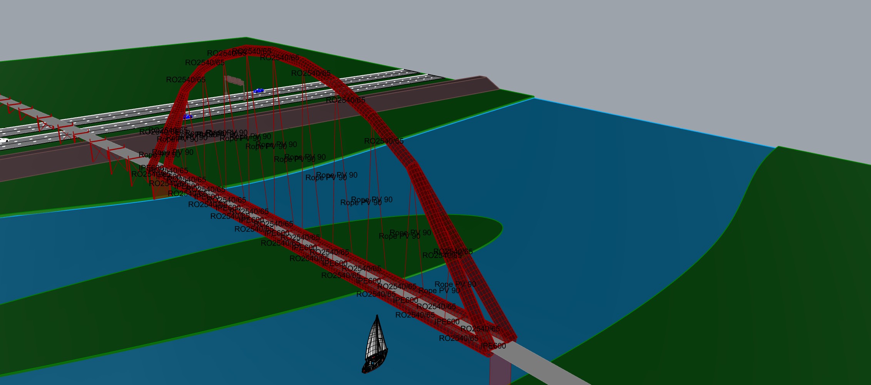
Arch results
MKI tbc…
Section properties

Slide 9
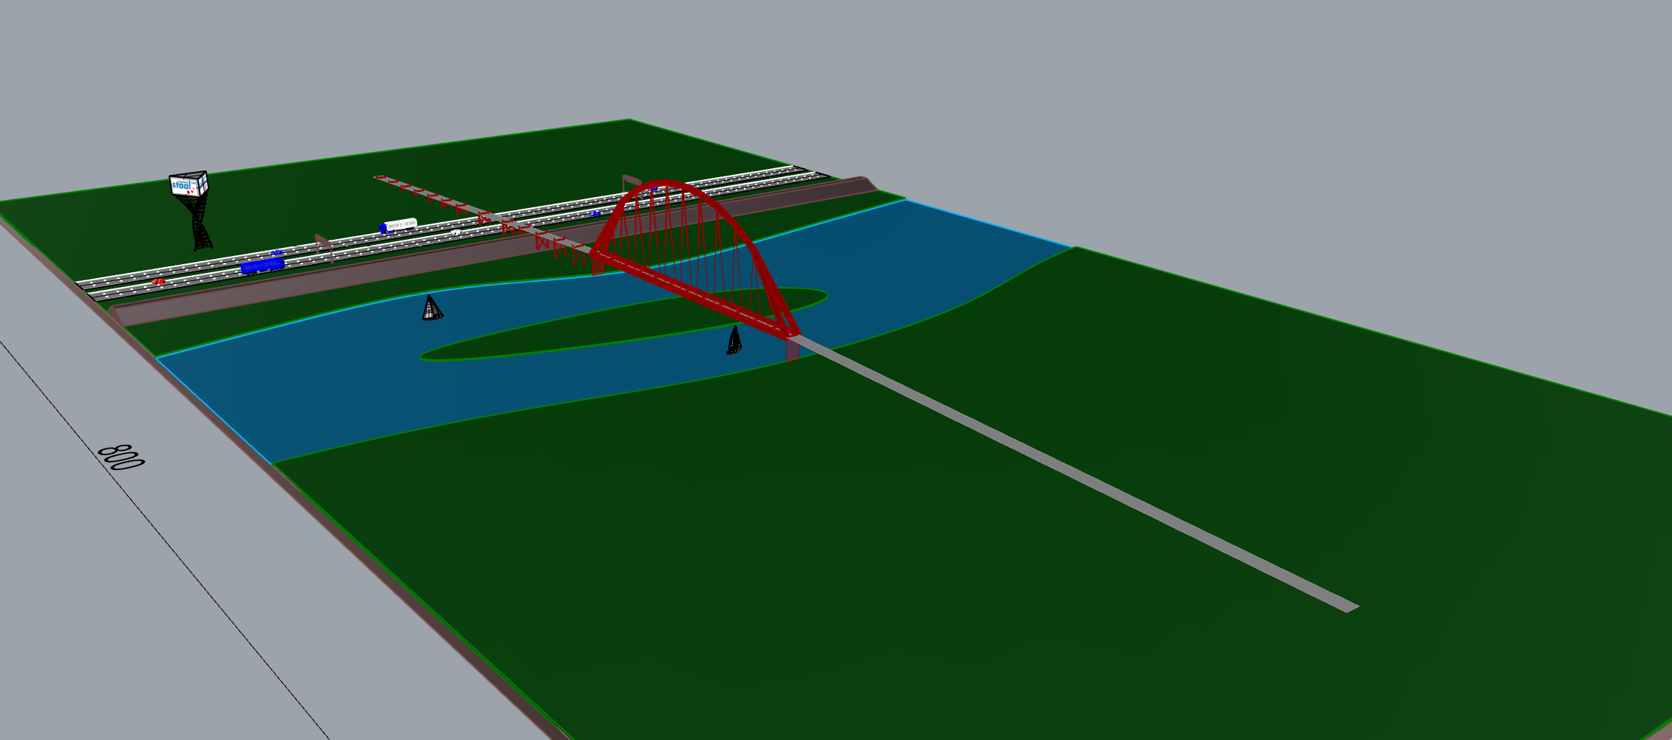
Goals defined at beginning of the day
Having fun
Learn something

