Slide 1
Upcycling steel with additive manufacturing
For a more sustainable future

Slide 2
The Team
AMI team – Additive Manufacturing Intelligence
Ethan
Thomas
Knut
Vera

Slide 3
Design Process
Setting parameters
Define path
Optimize path to boundary conditions
Set up structural model
Implement path into model
Run optimizer based on structural performance
Choose optimal design

Slide 4
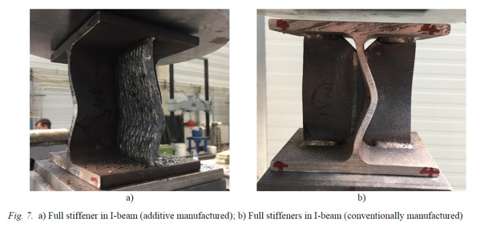
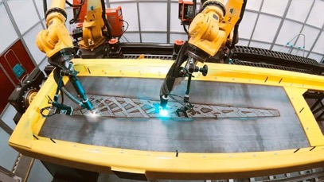
Reclaimed and reinforced steel
All steel is reclaimed
Reinforced, strengthened with additive manufacturing

Slide 5
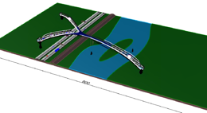
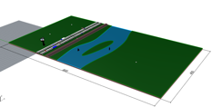
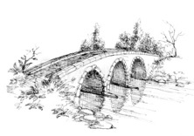
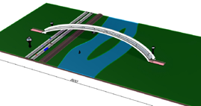
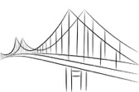
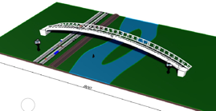
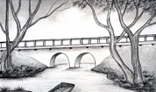
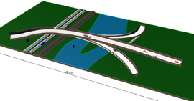
Community and AI Driven Design

Slide 6
Optimisation
Path Layout:
Entrance position
Pillar distribution
Height at intersection point
Structural:
Cross-sections
Constraints:
Path inclination
Road clear height
River clear height

Slide 7
Design Exploration

Slide 8
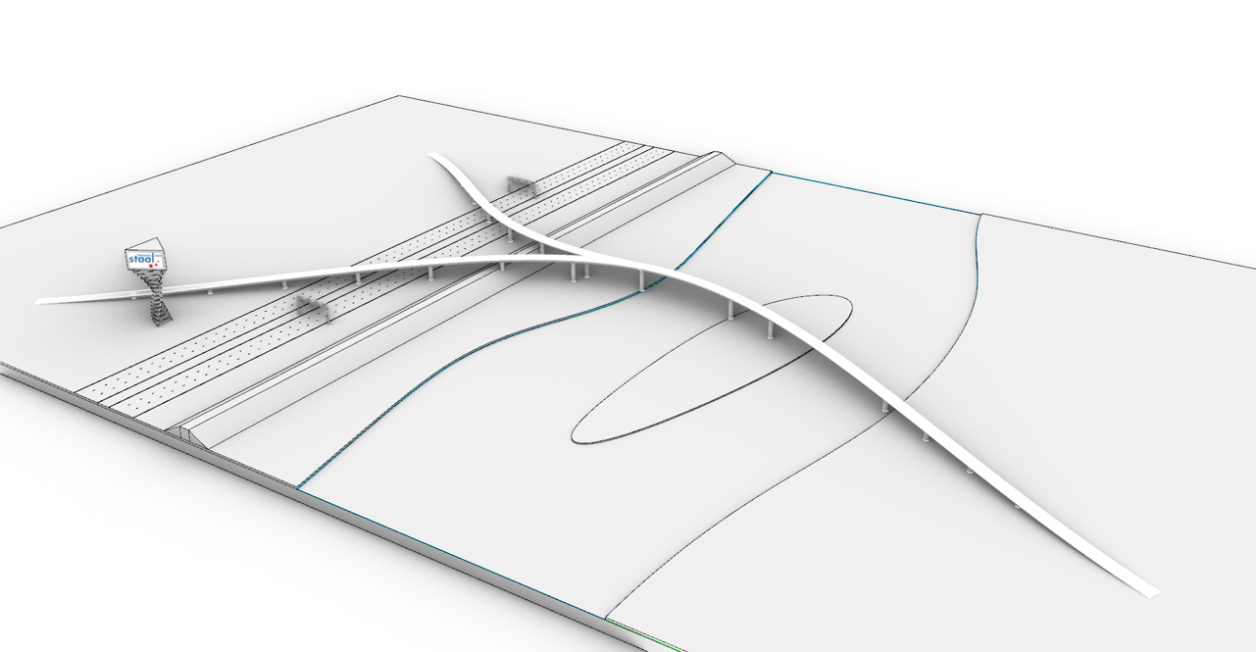
Optimised Path

Slide 9
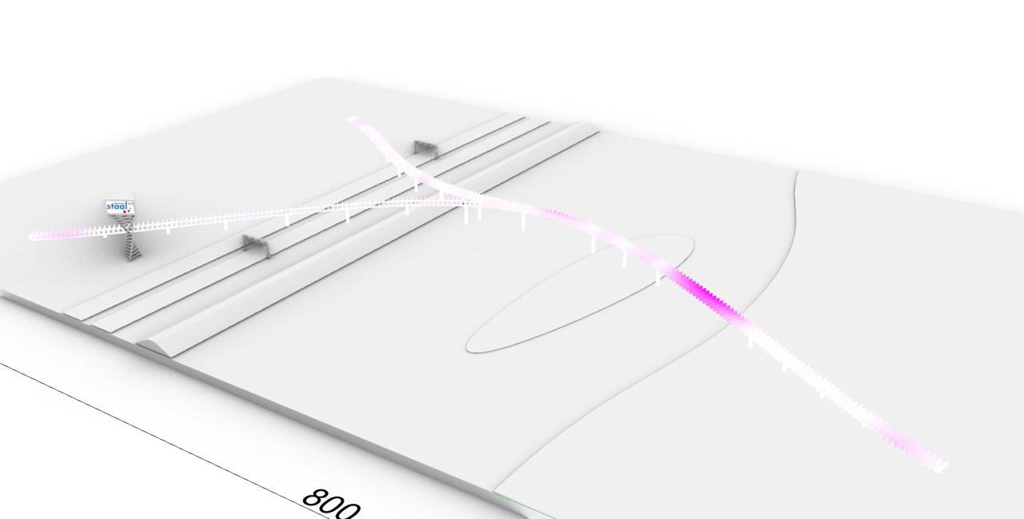
Structural Analysis

Slide 10
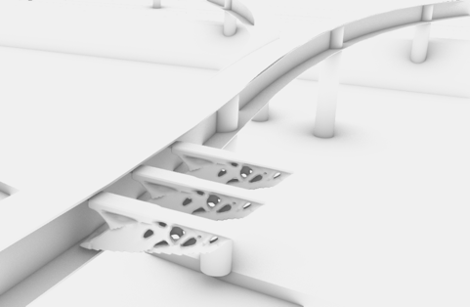
Detailed View

